Slide 1
Process Creation Part 1
Waqas Ali
waqas.ali2@uet.edu.pk

Slide 2
Process
A process is basically a program in execution.
To put it in simple terms, we write our computer programs in a text file and when we execute this program, it becomes a process which performs all the tasks mentioned in the program.

Slide 3
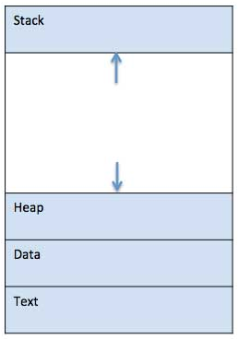
When a program is loaded into the memory and it becomes a process, it can be divided into four sections ─ stack, heap, text and data. The following image shows a simplified layout of a process inside main memory −

Slide 4
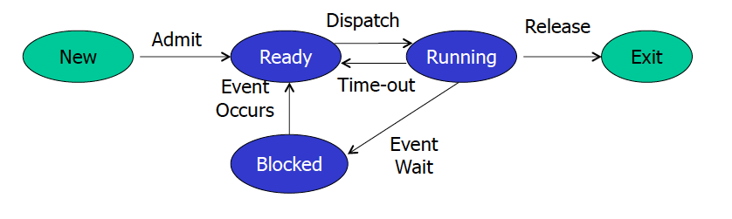
Process Life Cycle
When a process executes, it passes through different states. These stages may differ in different operating systems, and the names of these states are also not standardized.

Slide 5
Process Control Block (PCB)
A Process Control Block is a data structure maintained by the Operating System for every process.
The PCB is identified by an integer process ID (PID). A PCB keeps all the information needed to keep track of a process as listed below in the table

Slide 6
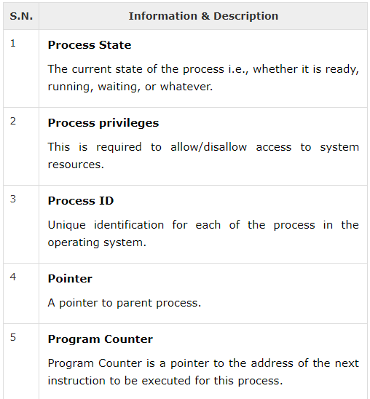

Slide 7
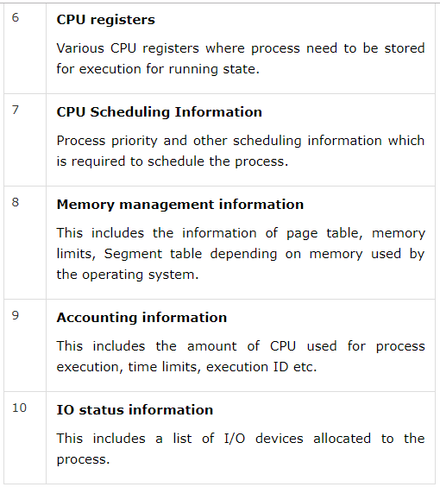

Slide 8
System Calls
fork()
exec()
wait()
exit()
getpid(), getppid()
getpgrp()

Slide 9
The “fork()” system call
A process calling fork()spawns a child process.
The child is almost an identical clone of the parent:
Program Text (segment .text)
Stack (ss)
P C B (eg. registers)
Data (segment .data)
The fork() is called once, but returns twice!
After fork()both the parent and the child are executing the same program.

Slide 10
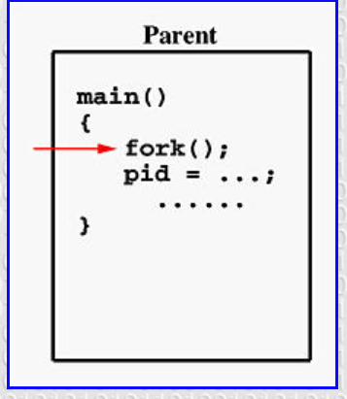
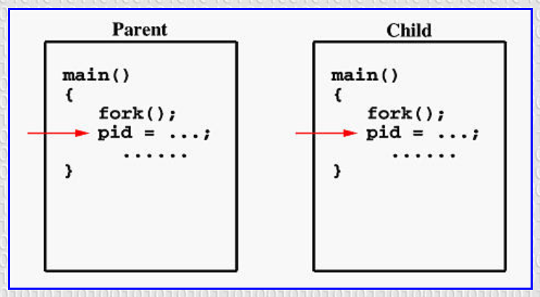

Slide 11
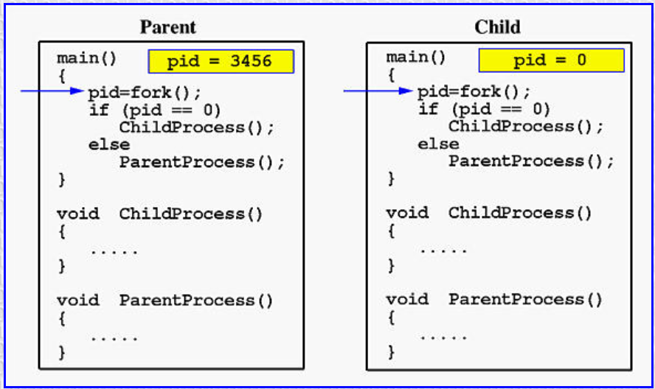

Slide 12
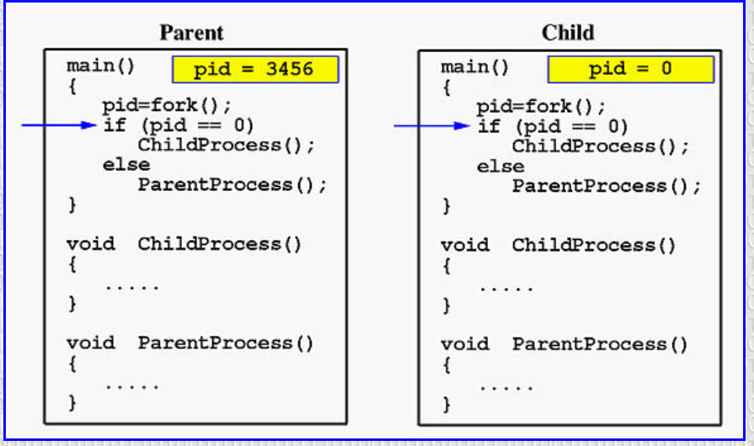

Slide 13
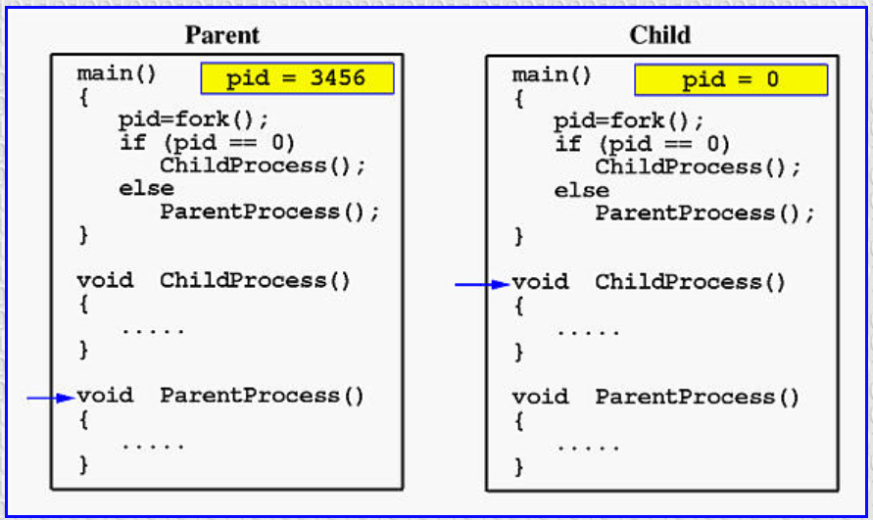

Slide 14
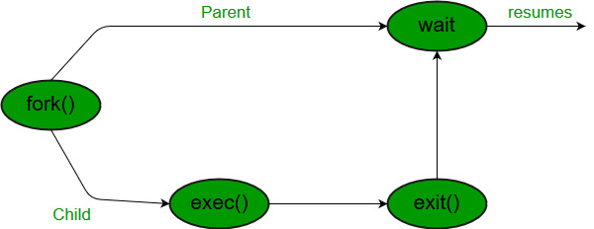

Slide 15

The “fork()” system call - PID
pid<0: the creation of a child process was unsuccessful.
pid==0: the newly created child.
pid>0: the process ID of the child process passes to
the parent.
Consider a piece of program
P1 PID:28
...
pid_t pid = fork(); printf(“PID: %d\n”, pid);
...
P1 PID:28
Fork()
C1 PID:34
The parent will print:
PID: 34
And the child will always print:
PID: 0

Slide 16
“fork()” Example
void main() {
int i;
printf("simpfork: pid = %d\n", getpid()); i = fork();
printf("Did a fork. It returned %d.
getpid = %d. getppid = %d\n“
, i, getpid(), getppid());
}
When simpfork is executed, it has a pid of 914. Next it calls fork() creating a duplicate process with a pid of 915.
The parent gains control of the CPU, and returns from fork() with a return value of the 915 -- this is the child's pid. It prints out this return value, its own pid, and the pid of C shell, which is 381.
Note: there is no guarantee which process gains control of the CPU first after a fork(). It could be the parent, and it could be the child.
Returns:
simpfork: pid = 914
Did a fork.It returned 915. getpid=914. getppid=381 Did a fork. It returned 0. getpid=915. getppid=914

Slide 17
The “exec()” System Call
The exec()call replaces a current process’ image with a new one (i.e. loads a new program within current process).
The new image is either regular executable binary file or a
shell script.
There’s not a syscall under the name exec(). By
exec()we usually refer to a family of calls:
int execl(char *path, char *arg, ...);
int execv(char *path, char *argv[]);
int execle(char *path, char *arg, ..., char *envp[]);
int execve(char *path, char *argv[], char *envp[]);
int execlp(char *file, char *arg, ...);
int execvp(char *file, char *argv[]);
Where l=argument list, v=argument vector, e=environmental vector, and p=search path.

Slide 18

The “exec()” System Call
Upon success, exec()never returns to the caller. It replaces the current process image, so it cannot return anything to the program that made the call. If it does return, it means the call failed. Typical reasons are: non- existent file (bad path) or bad permissions.
Arguments passed via exec()appear in the argv[] of the main()
function.
As a new process is not created, the process identifier (PID) does not change, but the machine code, data, heap, and stack of the process are replaced by those of the new program.
For more info: man 3 exec;
P1 PID:28
Exec()
P1 PID:28
Old Program
New Program

Slide 19
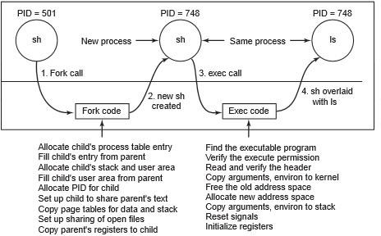


“fork()” and “exec()” combined
Often after doing fork() we want to load a new program into the child. E.g.: a shell
P1 PID:28
fork()
C1 PID:34
C1 PID:34
exec(ls)
C1 PID:34
Old Program
New Program

Slide 20
The “wait()” system call
Forces the parent to suspend execution, i.e. wait for its children or a specific child to die (terminate).
When the child process dies, it returns an exit status to the operating system, which is then returned to the waiting parent process. The parent process then resumes execution.
A child process that dies but is never waited on by its parent becomes a zombie process. Such a process continues to exist as an entry in the system process table even though it is no longer an actively executing program.

Slide 21
The “wait()” system call
The wait() causes the parent to wait for any child process.
The waitpid() waits for the child with specific PID.
pid: pid of (child) process that
the calling process waits for.
status: a pointer to the location where status information for the terminating process is to be stored.
options: specifies optional actions.
The return value is:
PID of the exited process, if no error
(-1) if an error has happened
#include <sys/types.h> #include <sys/wait.h>
pid_t wait(int *status);
pid_t waitpid(pid_t pid,
int *status, int options);

Slide 22
When wait() returns they also define exit status (which tells us, a process why terminated) via pointer, If status are not NULL.
If any process has no child process then wait() returns immediately “-1”.

Slide 23
Child status information: Status information about the child reported by wait is more than just the exit status of the child, it also includes
normal/abnormal termination
termination cause
exit status

Slide 24
For find information about status, we use WIF….macros
1. WIFEXITED(status): child exited normally • WEXITSTATUS(status): return code when child exits
2. WIFSIGNALED(status): It determines if the child process exited because it raised a signal that caused it to exit. • WTERMSIG(status): gives the number of the terminating signal
3. WIFSTOPPED(status): child is stopped • WSTOPSIG(status): gives the number of the stop signal

Slide 25
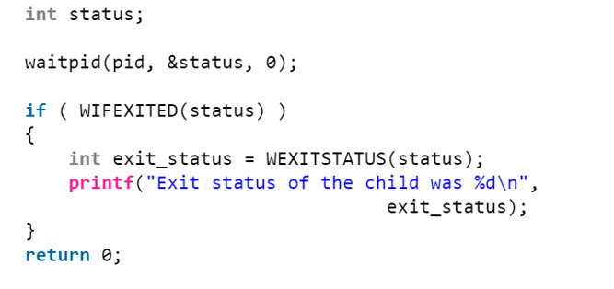

Slide 26
The “exit()” system call
This call gracefully terminates process execution. Gracefully means it does clean up and release of resources, and puts the process into the zombie state.
By calling wait(), the parent cleans up all its zombie children.
When the child process dies, an exit status is returned to the operating system and a signal is sent to the parent process. The exit status can then be retrieved by the parent process via the wait system call.

Slide 27


Slide 28
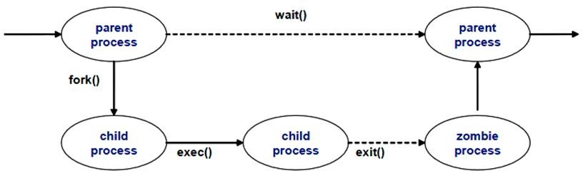
The process states
Zombie: has completed execution, still has an entry in the process table
Orphan: parent has finished or terminated while this process is still
running
Daemon: runs as a background process, not under the direct control of an interactive user
A zombie process

Slide 29
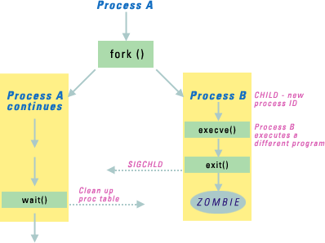

Slide 30
https://www.geeksforgeeks.org/wait-system-call-c/
https://www.geeksforgeeks.org/exit-status-child-process-linux/
https://www.softprayog.in/programming/creating-processes-with-fork-and-exec-in-linux
https://www.csl.mtu.edu/cs4411.ck/www/NOTES/process/fork/create.html
https://aljensencprogramming.wordpress.com/2014/03/
https://www.geeksforgeeks.org/understanding-exit-abort-and-assert/
http://www.embhack.com/the-wait-system-call/

